Slide 1

Cardiovascular Disease Prediction
AISC-1006 Steps Presentation
Group - C

Slide 2
Index
Recap
Modularizing
Models
Model Evaluation
Model Selection

Slide 3
Introduction-SCOPE AND OBJECTIVES
Objective
Importance
Problem statement
Our project aims to predict cardiovascular disease using machine learning.
Importance of early detection and prevention of heart attacks
Statistics on the prevalence of heart disease and its impact
Machine learning as a powerful tool for predictive modeling
Our aim is to leverage machine learning techniques to analyze and accurately identify individuals at risk of developing cardiovascular disease based on various health metrics.
The target is binary classification which is '0' for absence and '1' for presence of heart disease.

Slide 4
Recap
Data collection
Data preprocessing
Scaling
Exploratory Data Analysis
Feature Engineering
Feature selection

Slide 5
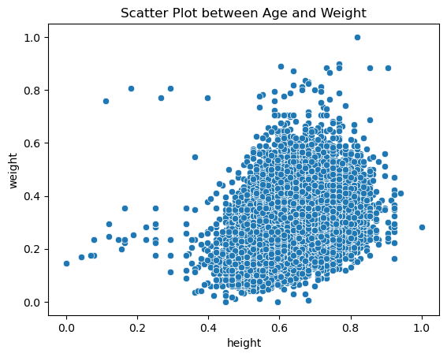
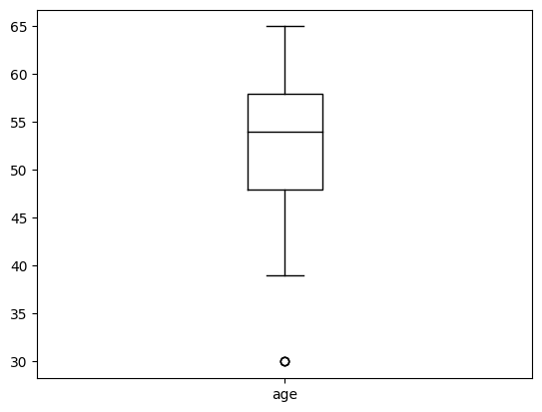
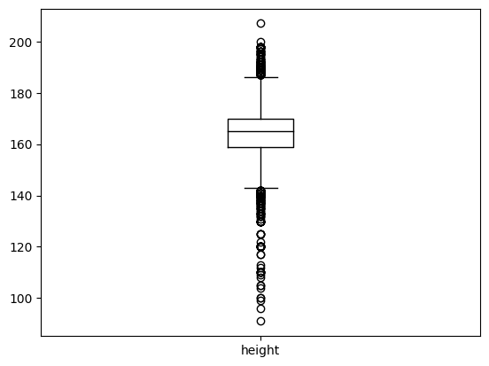
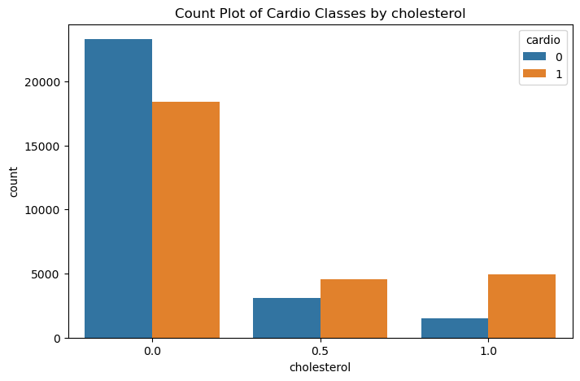
Exploratory Data Analysis (EDA)
Univariate Analysis: Analyzing the distribution of individual variables to understand their characteristics and identify potential outliers or anomalies.
Bivariate Analysis: Investigating relationships between pairs of variables to uncover patterns and dependencies that may be relevant for predicting cardiovascular disease.

Slide 6
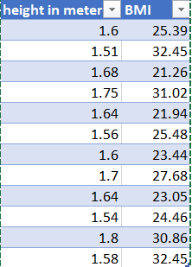
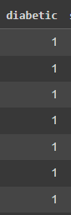
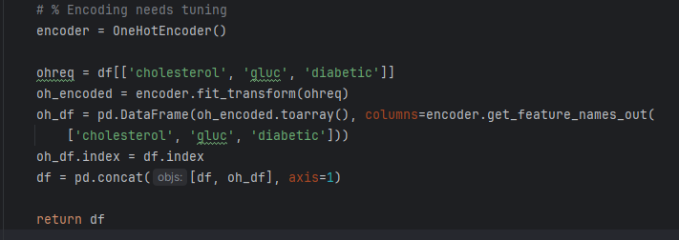
Feature Engineering
Feature engineering played a pivotal role in enhancing the predictive capabilities of our models. The following feature engineering techniques were employed:
Deriving BMI: Body Mass Index (BMI) was calculated using the formula BMI = weight / (height)^2, providing a standardized measure of body composition.
One-Hot Encoding: Categorical variables such as cholesterol and glucose levels were one-hot encoded to represent them as binary vectors, facilitating their incorporation into machine learning models.

Slide 7
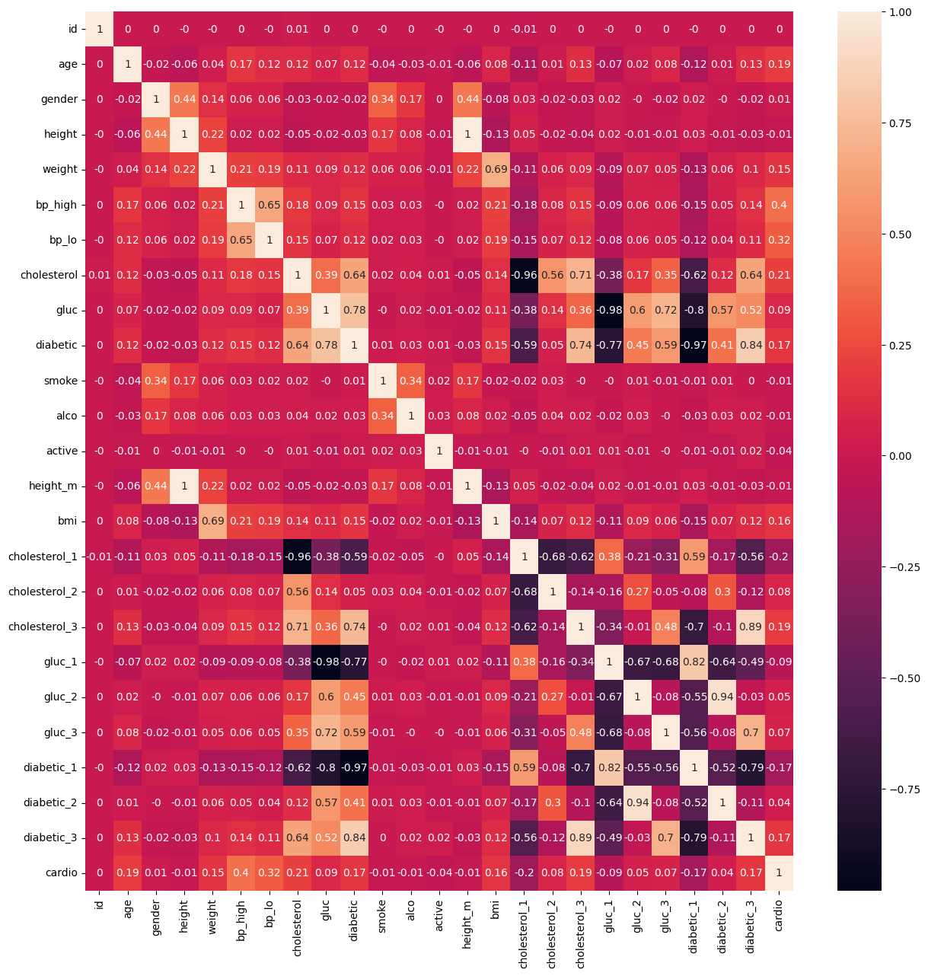
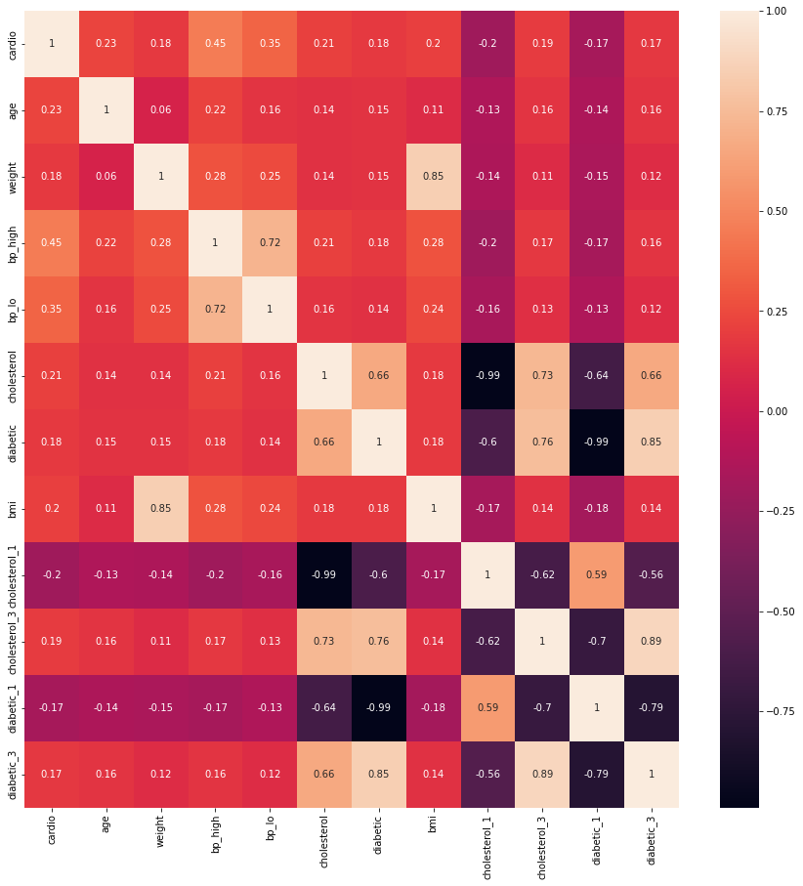
Feature Selection
Spearman Correlation: Calculating the Spearman correlation coefficient to assess the strength and direction of monotonic relationships between variables, particularly their correlations with the target variable.
Selecting relevant features based on their correlation with the target variable (‘y_train’), ensuring that the model is trained on the most informative variables for predicting cardiovascular disease.

Slide 8
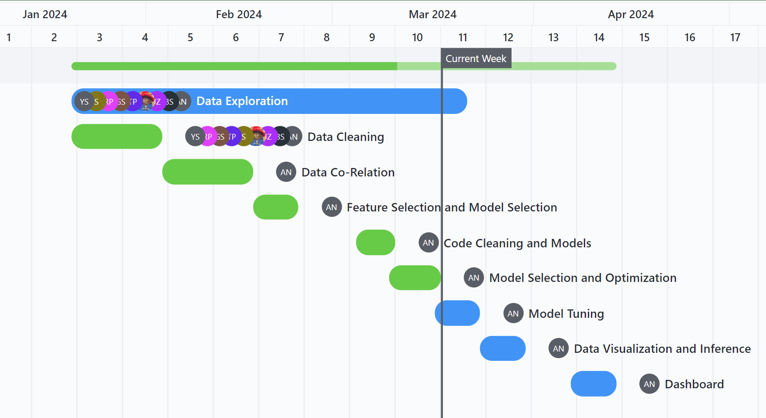
Gantt chart

Slide 9
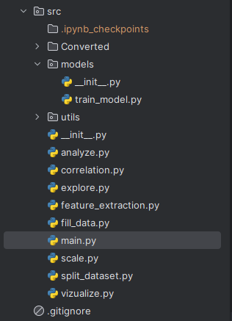
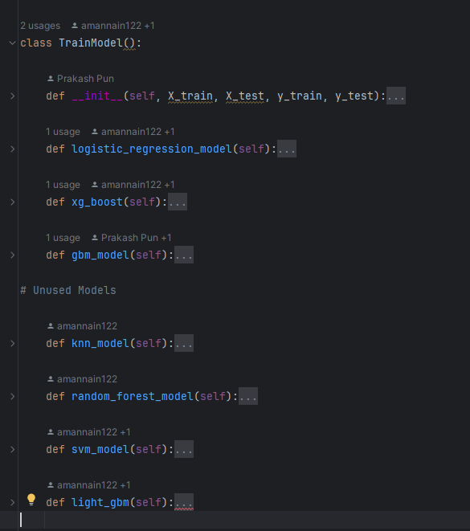
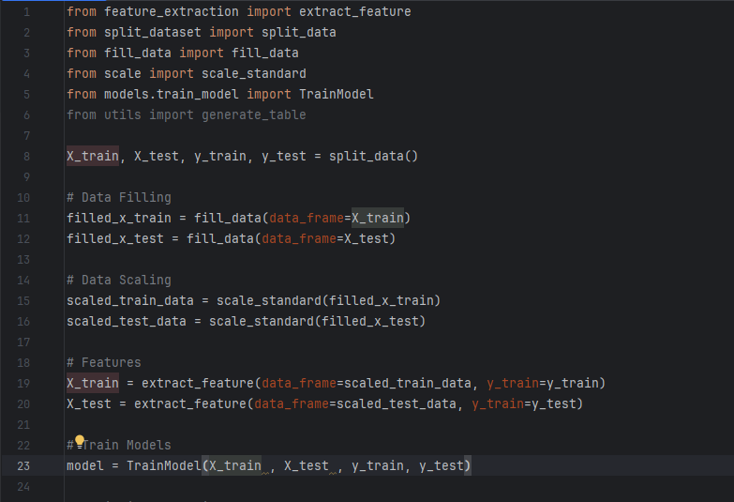
Modularizing
Improved Readability and Maintainability
Code Reusability
Enhanced Collaboration
Scalability and Flexibility

Slide 10
What are Machine Learning Models
Continuous Learning
Data Analysis and Patterns
Predictive Algorithms
Machine learning models are dynamic and capable of continuous learning, adapting to new data and evolving trends like in heart attack risk factors. This adaptability enhances their ability to provide real-time, reliable predictions for individuals at different stages of life.
Machine learning algorithms analyze vast amounts of medical data to identify complex patterns and correlations associated with heart attacks. By recognizing subtle relationships, these models can provide more accurate predictions than traditional risk assessment methods.
Sophisticated predictive algorithms, such as neural networks and decision trees, can effectively process diverse patient information, including medical history, genetic markers, and lifestyle factors. This allows for personalized risk assessment and early intervention strategies.

Slide 11
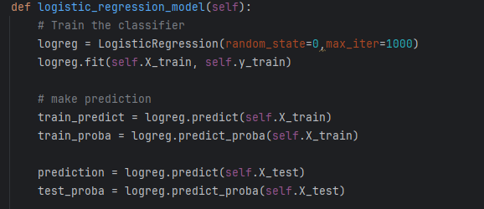
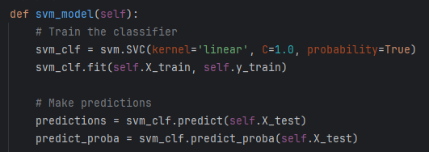
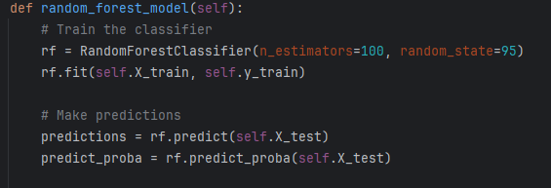
Models
Logistic Regression
Simple and interpretable
Suitable for binary classification tasks based on its features.
SVM Model
Effective in handling high-dimensional data and finding optimal hyperplanes
Useful for binary classification tasks with complex decision boundaries.
Random Forest Model
Able to handle high-dimensional data and complex relationships between features, by constructing multiple decision trees and aggregating their predictions to achieve robust classification results.

Slide 12
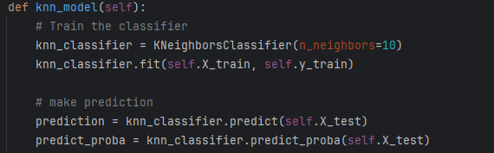
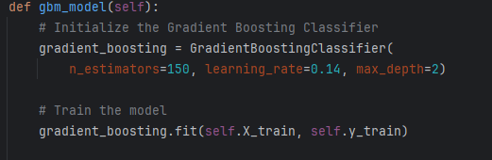
Models
KNN Classifier
Simple and effective in handling non-linear relationships in data
Classification decisions are based on the k-nearest neighbors of a data point.
Gradient Boosting
Able to iteratively train weak learners and optimize a differentiable loss function
Effective in minimizing errors and improving classification accuracy with each iteration.

Slide 13
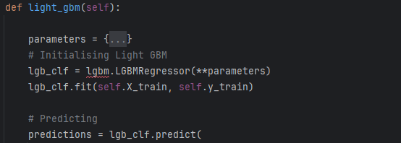
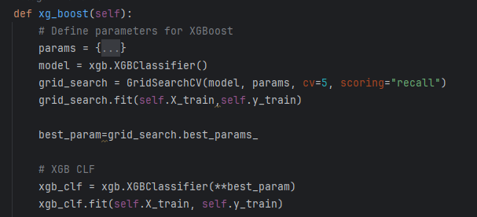
Models
Light GBM
Highly efficient in handling large datasets
capable to achieve high performance through gradient boosting
Reduces training time and memory usage.
XGBoost_CLF
Similar to Light GBM
High performance and scalability
Uses gradient boosting techniques to improve classification accuracy by combining the predictions of multiple weak learners.

Slide 14
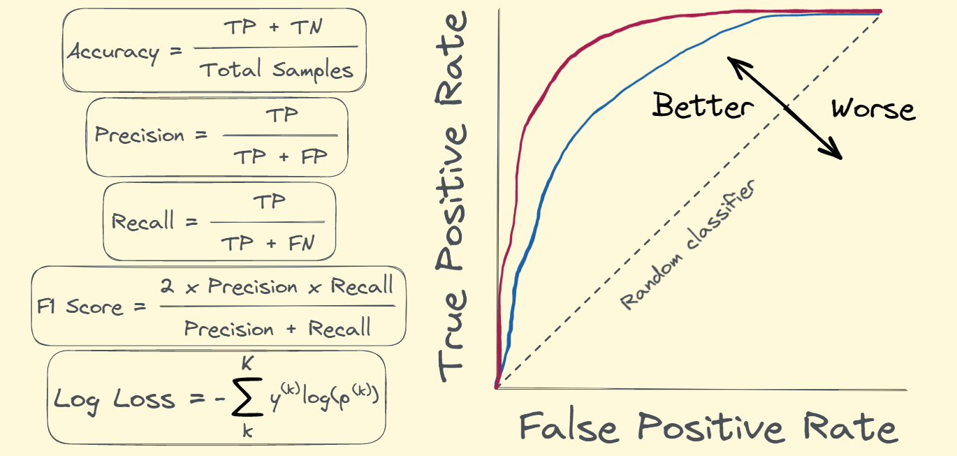
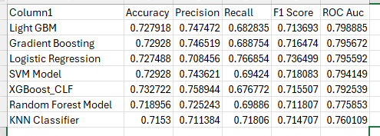
Model Evaluation
Accuracy: Provides overall correct prediction proportion, but caution in imbalanced datasets.
Precision: Gauges true positive proportion among all positive predictions, essential for minimizing false positives.
Recall: Measures true positive identification rate, critical for minimizing false negatives.
F1 Score: Balances precision and recall, particularly useful for imbalanced datasets.
ROC AUC: Measures model's class separation ability, unaffected by class distribution.

Slide 15
Model Selection
Based on above metrics we come to conclusion and chose to work on 3 models that are:
Logistic regression
Gradient Boosting
Xgboost_CLF
As they were providing best results

Slide 16
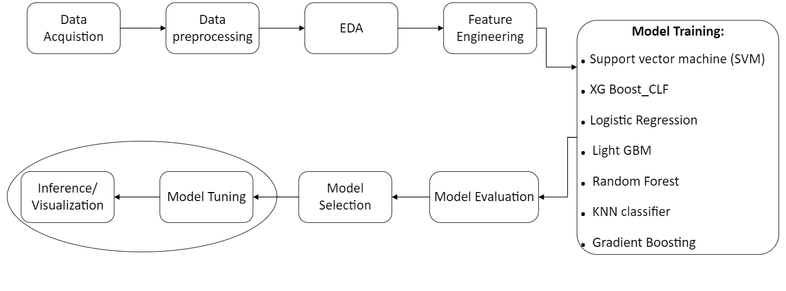
In next weeks…
Model Tuning
We will conduct extensive hyperparameter tuning for our machine learning models to optimize their performance.
Visualizing
We will visualize all the data and the result we got from our models.

Slide 17

Thank you

